Slide 1
Topic 4: User Behaviour
(Part 3)
EMOTIONAL
INTERACTION
SECV2113 Human-Computer Interaction
Faculty of Computing
Universiti Teknologi Malaysia

Slide 2
EMOTIONS AND BEHAVIOUR
01
EXPRESSIVE INTERFACES
02
AFFECTIVE COMPUTING & EMOTIONAL AI
03
PERSUASIVE TECHNOLOGY & BEHAVIOURAL CHANGE
04
ANTHROPOMORPHISM
05

Slide 3
EMOTIONS &
BEHAVIOUR

Slide 4
Emotions and Behaviour
HCI has traditionally been about designing efficient and effective systems
Now more about how to design interactive systems that make people respond in certain ways
For example, to be happy, to be trusting, to learn, or to be motivated
Emotional interaction is concerned with how we feel and react when interacting with technologies
Affective computing is improving with better recognition software and machine learning algorithms

Slide 5
Emotional Interaction
What makes us happy, sad, annoyed, anxious, frustrated, motivated, delirious, and so on
Translating this into different aspects of the user experience
Why people become emotionally attached to certain products (for instance, virtual pets)
Can social robots help reduce loneliness and improve well-being?
How to change human behaviour through the use of emotive feedback

Slide 6

Activity
Try to remember the emotions you went through when buying a big-ticket item online (for example, a refrigerator, a vacation, a computer)
How many different emotions did you go through?

Slide 7
The online shopping experience
First, there is the realisation of needing or wanting it, and then the desire and anticipation of purchasing it.
This is followed by the joy or frustration of finding out more about what products are available and deciding which to choose from potentially hundreds or even thousands (by visiting numerous websites, such as comparison sites, reviews, recommendations, blogs).
The thrill of deciding on a purchase may be quickly followed by the shock of how much it costs and the disappointment that you can’t afford it.
The process of having to decide again may be accompanied by annoyance as you can’t find one that is as good as your first choice.
You think about other options, such as seeking advice from an expert in a shopping mall, but you have an aversion to sales assistants and don’t trust their advice, because you think they have their own interests (making money), rather than yours, at heart.
So you carry on looking, getting more tired and frustrated. When you do make a decision you experience a sense of relief.
You click merrily though the various options (such as color, size, warranty) and then the dreaded online payment form pops up. You type in all your details and press the final payment button.
A window then appears saying that your credit card number is incorrect. So you cautiously type it in again, very slowly. And you notice you need to type the 3 number security code in again.
Finally, when all is done you let out a big sigh. But as you walk away from your computer doubts start to form in your mind – maybe you should have bought the other one...

Slide 8
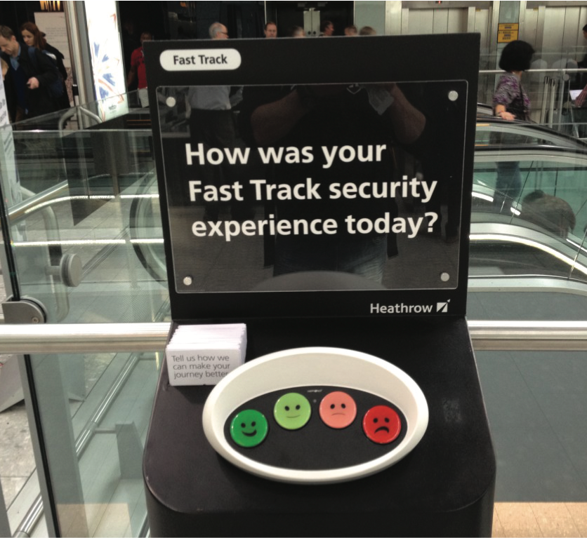
Why has this simple way of obtaining visitor feedback been so effective?

Slide 9
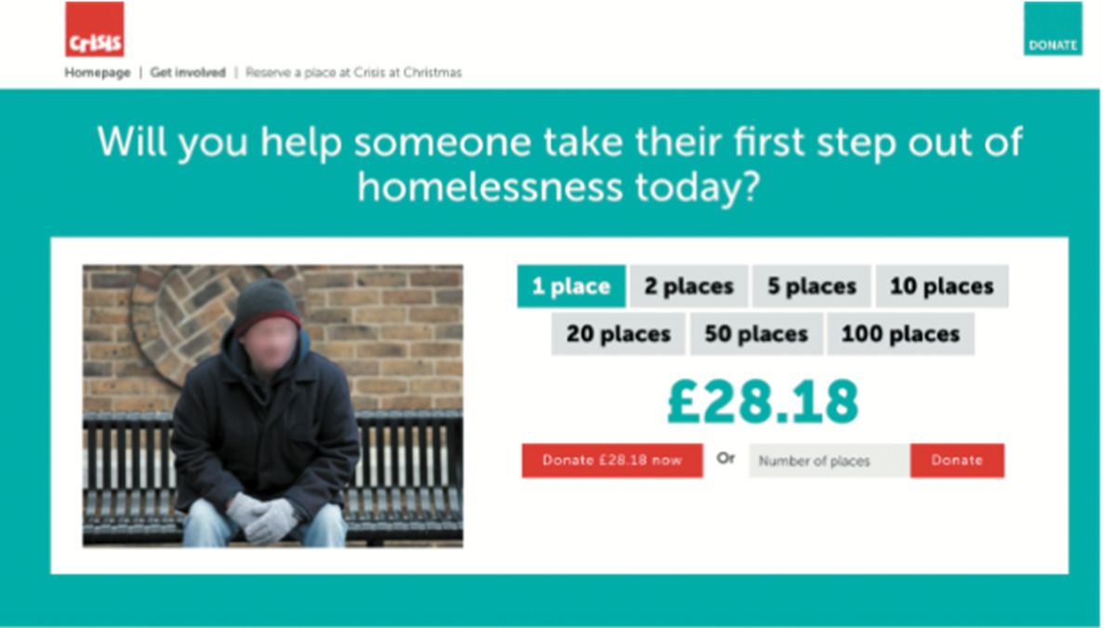
Pulling at the heart strings with an emotive message

Slide 10
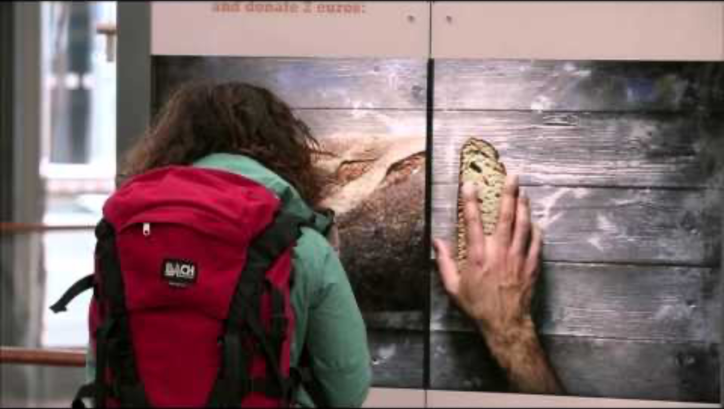
Pulling at the heart strings with an emotive message

Slide 11
Is it possible to design an interface to match or change how we are feeling?
Should an interface be designed to improve how we feel?
If so, how?
Our moods and feelings are continuously changing
How does the interface keep track and know when to do something?
What moods match which kinds of interfaces?
How would you design an interface for when someone is happy, angry, sad, bored, or focused?

Slide 12
How do emotions affect behaviour and vice versa?
Does being angry make you concentrate better or more distracted?
When you are happy do you take more risks such as spend more money or buy more?
Baumeister et al (2007) argue the relationship is more complex than a single cause-and-effect model

Slide 13
Automatic (affect) vs.
Conscious Emotions
Emotions can be short-lived (for instance, a fit of anger) or complex and long-lasting (for example, jealousy)
Emotions have been categorised as automatic or conscious:
Automatic ones are rapid and dissipate quickly
Conscious ones develop slowly and take a long time to go (for instance, reflection)

Slide 14
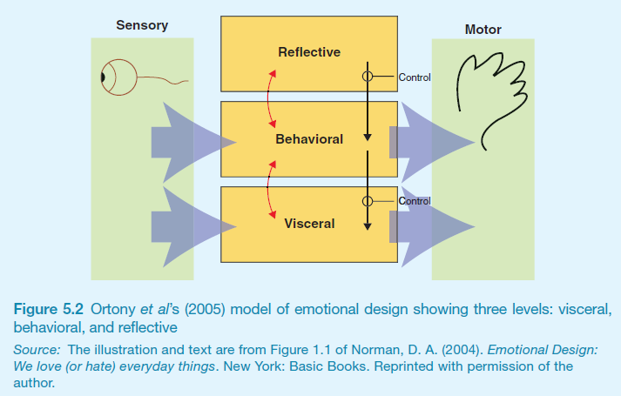
Emotional Design Model

Slide 15
Claims from Model
Our emotional state changes how we think
When frightened or angry, we focus narrowly and our bodies respond by tensing muscles and sweating
More likely to be less tolerant
When happy, we are less focused and our bodies relax
We are more likely to overlook minor problems and be more creative

Slide 16
Designing with the 3-levels in mind
Visceral design refers to making products look, feel, and sound good
Behavioural design is about use, and it equates with traditional values of usability
Reflective design is about considering the meaning and personal value of a product

Slide 17
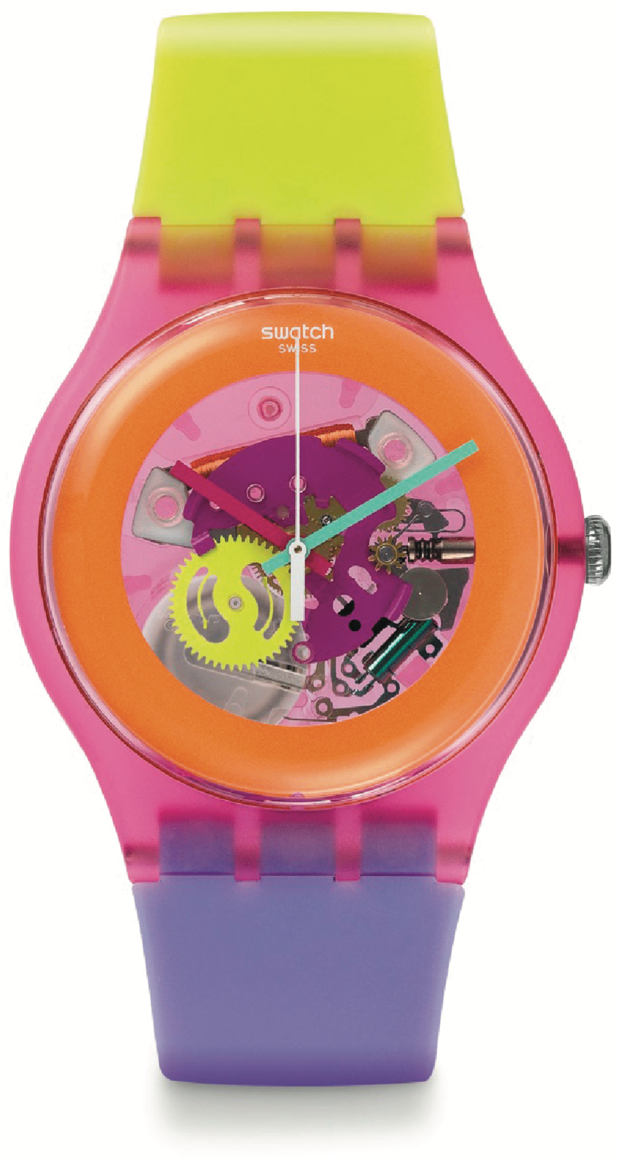
Analysing a Swatch watch design using the model
Cultural images and graphical elements designed at the reflective level
Affordances of use at the behavioral level
Brilliant colours and wild design attract user’s attention at the visceral level

Slide 18
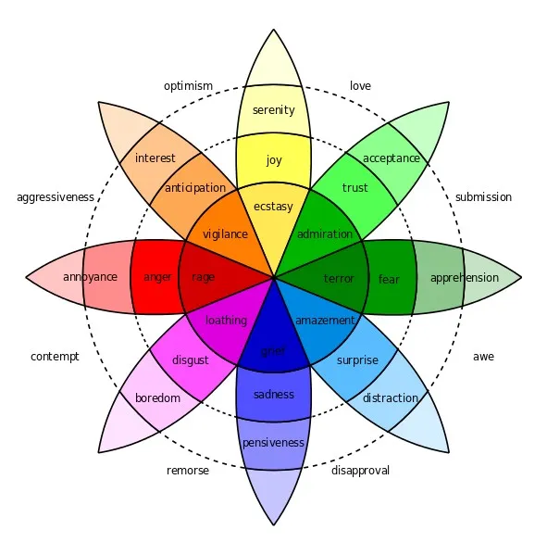
Plutchik’s (1980) Wheel of Emotions

Slide 19
Plutchik’s Wheel
Categorises human emotions into 7 well known emotions
Anger, Disgust, Fear, Sadness, Anticipation, Joy and Surprise and Trust (not usually considered an emotion)
Emotional labels are added to these
optimism, love, submission, awe, disproval, remorse, contempt, aggressiveness
Colours used in the wheel reflect the intensity of an emotion
the darker the shade, the more intense the emotion is
Can be used as a ‘colour palette’ akin to a UX mood board
elicit different kinds and levels of emotional response
It does not provide prescriptive advice on how to instruct design for a selection of emotions

Slide 20
EXPRESSIVE
INTERFACES

Slide 21


Expressive Interfaces
Provide reassuring feedback that can be both informative and fun
Can also be intrusive, however, causing people to become annoyed and even angry
Colour, icons, sounds, graphical elements, and animations are used to make the ‘look and feel’ of an interface appealing
Conveys an emotional state
In turn, this can affect the usability of an interface
People are prepared to put up with certain aspects of an interface (for instance, slow download rate) if the end result is appealing and aesthetic

Slide 22
The Appearance of an Interface
(a) Emotional icons were used in the 1980s to indicate rebooting or crashed computer
Smiling apple face
(b) Nowadays, computers use more impersonal but aesthetically-pleasing icons to indicate that the user needs to wait
Beachball

Slide 23
The Design of Thermostats
(a) The Nest thermostat has a minimalist and aesthetically-pleasing design
Round face and simple dial
Large font and numbers
(b) It is very different from earlier thermostat designs
Utilitarian and dull

Slide 24

Design of Website to be Aesthetics

Slide 25
AFFECTIVE COMPUTING
& EMOTIONAL AI

Slide 26
Affective Computing & Emotional AI
Affective computing is concerned with how to use computers to recognise and express emotions as humans do (Picard, 1998)
It involves designing ways for people to communicate their emotional state
It uses sensing technologies to measure GSR, facial expressions, gestures, and body movement
Explores how affect influences personal health
Emotional AI aims to automate the measurement of feelings and behavior using AI to infer them from facial expressions and voice
The goal is to predict user’s emotions and aspects of their behavior
For example, what is someone most likely to buy online when feeling sad, bored, or happy

Slide 27
Techniques Used
Cameras for measuring facial expressions
Biosensors placed on fingers or palms to measure GSR
Affective expression in speech (for example, intonation, pitch, and loudness)
Body movement and gestures using accelerometers and motion capture systems

Slide 28
Classification of Emotions
Six core expressions typically measured:
Sadness, disgust, fear, anger, contempt, and joy
Type of facial expression chosen by AI through detecting presence of absence of:
Smiling, eye widening, brow raising, brow furrowing, raising a cheek, mouth opening, upper-lip raising, and wrinkling of the nose

Slide 29
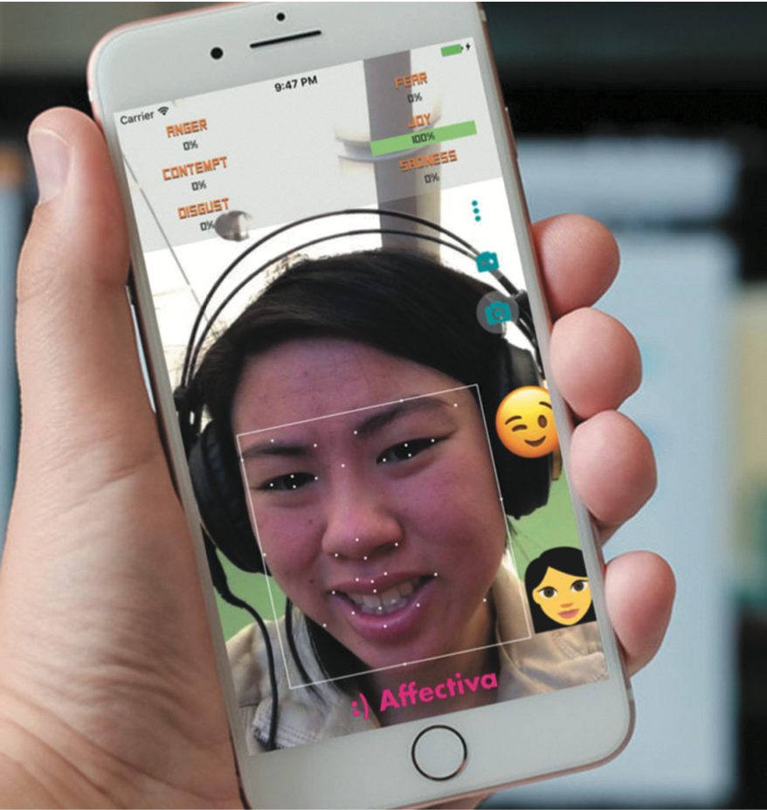
Facial Coding using Affdex software

Slide 30
How is this Emotional Data used?
If user screws up their face when an ad pops up
Feel disgust
If user starts smiling
They are feeling happy
Website can adapt its ad, movie storyline, or content to match user’s emotional state
If system used in a car, it might detect an angry driver and suggest they take a deep breath
Eye-tracking, finger pulse, speech, and words/phrases also analyzed when tweeting or posting to Facebook

Slide 31
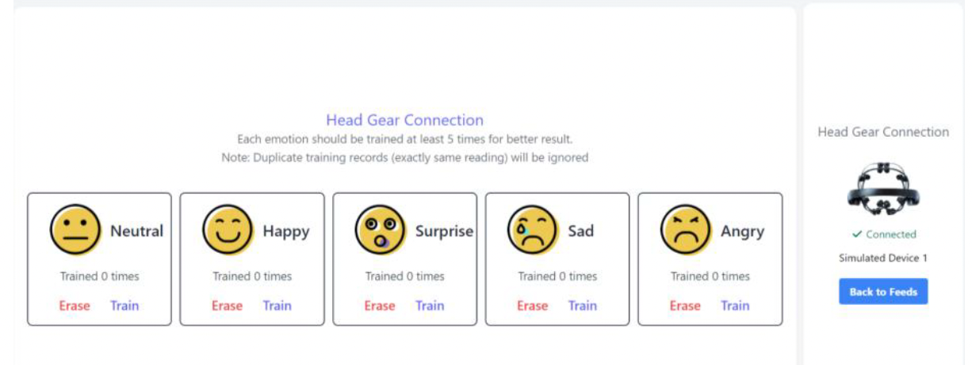
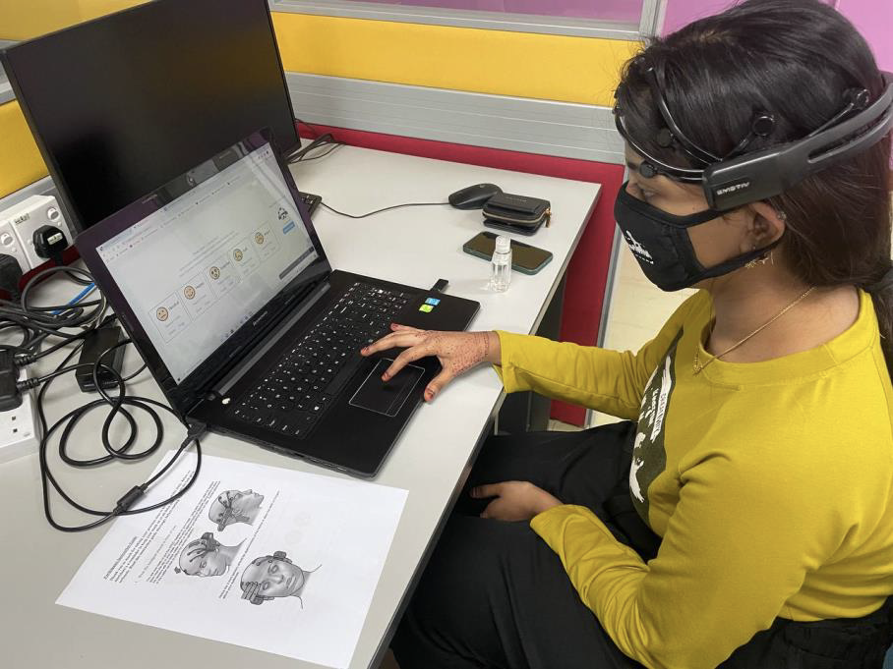
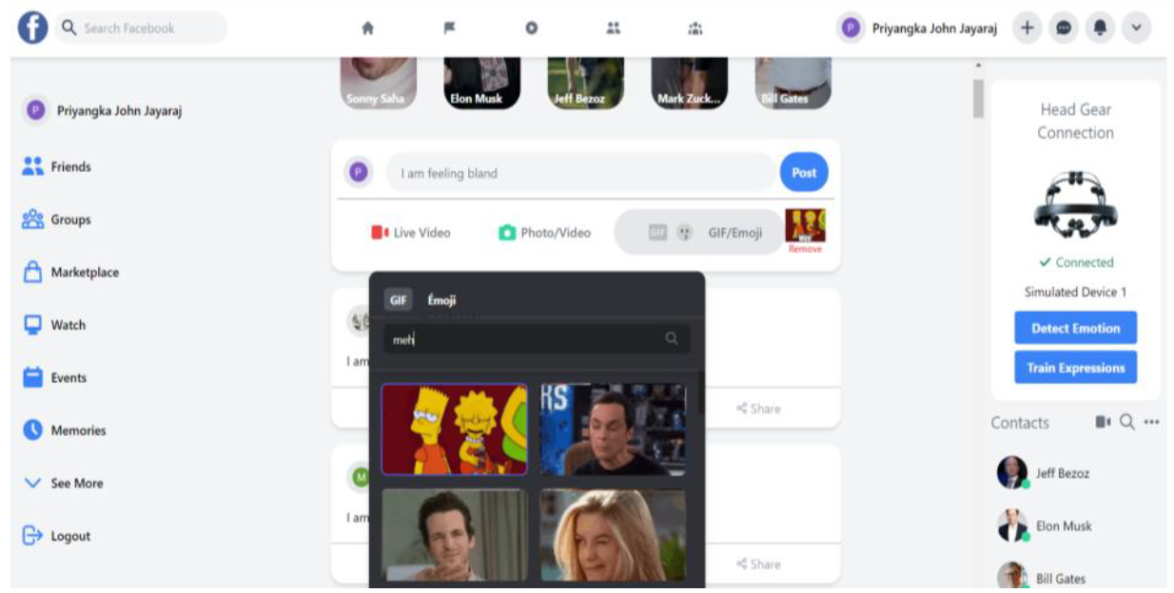
Detecting & Expressing Emotions
Publication:
Priyangka John Jayaraj and Masitah Ghazali. User’s Perspectives on Expressing Emotions on Social Media Platforms with Mobile Brain-Computer Interface. In Fusion 2021 Proceedings of 3rd National Symposium on Human-Computer Interaction, 19th August 2021, pp. 8-17. eISBN: 978-967-18511-1-1

Slide 32
Indirect Emotion Detection
Also used to infer or predict someone’s behaviour
e.g, determining a person’s suitability for a job or how they will vote in an election
Do you think it is ethical that technology can read your emotions from your facial expressions or from your tweets?

Slide 33
Detecting and Reflecting on Moods
How can technology be designed to help people understand more about their moods and mood swings?
We can be in a good mood one day and then a bad mood the next day. How does this happen and why?
Not possible to detect different moods in the way tech is used for emotion detection
often not expressed through obvious physiological responses
Mobile mood tracker apps (e.g., Moodnotes, Daylio)
intended to help people keep track of their moods
to reflect more on why they might be feeling gloomy or cheerful
understanding their moods is assumed to help improve well-being
Virtual reality is also used to enable people to explore their moods (e.g. Mood Worlds)

Slide 34
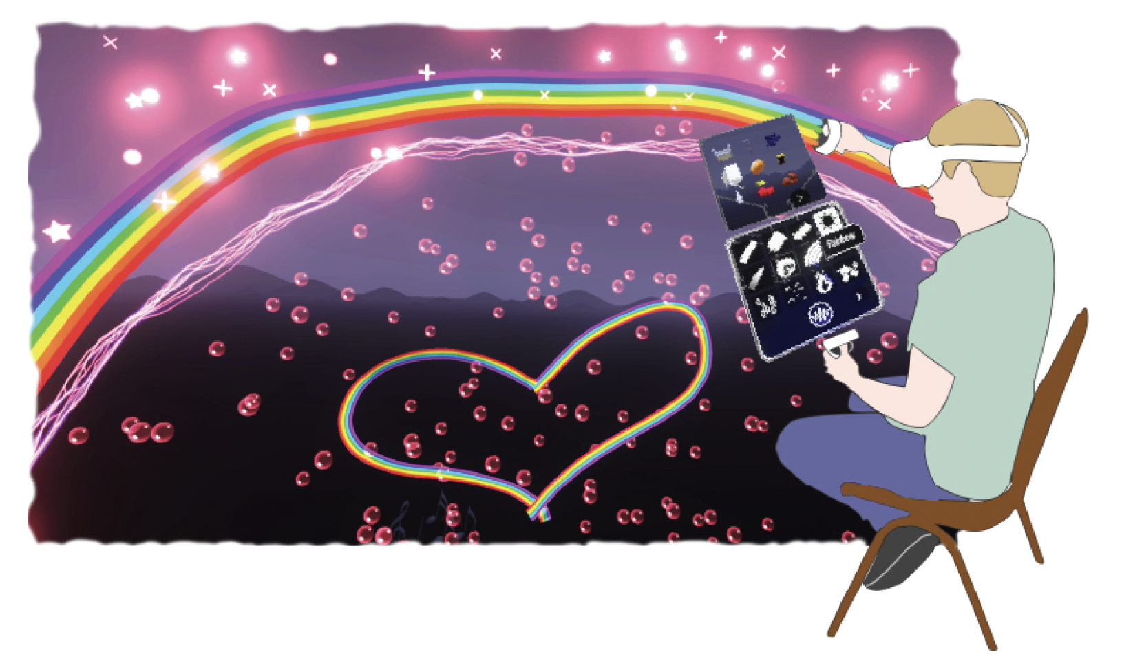
Mood Worlds: a VR exploratory tool
Nadine Wagener et al (2022)

Slide 35
PERSUASIVE TECHNOLOGIES
& BEHAVIOURAL CHANGE

Slide 36
Persuasive Technologies
& Behavioural Change
Interactive computing systems designed to change people’s attitudes and behaviors (Fogg, 2003)
A diversity of techniques now used to change what they do or think
Pop-up ads, warning messages, reminders, prompts, personalized messages, recommendations, or Amazon 1-click
Commonly referred to as nudging

Slide 37
Nintendo’s Pocket Pikachu
Developed to change bad habits and improve well being
Designed to motivate children to be more physically active on a regular basis
Owner of the digital pet that ‘lives’ in the device is required to walk, run, or jump
If owner does not exercise, the virtual pet becomes angry and refuses to play anymore

Slide 38
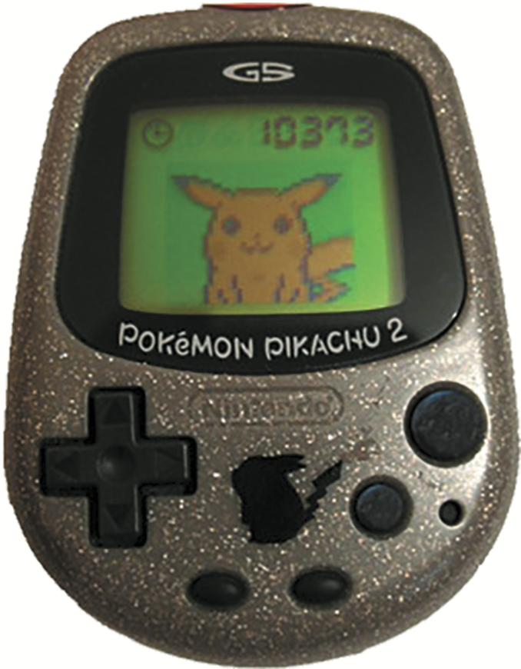
How Effective?
Can interactive technologies that monitor, nag, or behave like a human keep them interested in looking after it and in doing so make themselves more fit?
How does looking after a virtual pet change a child’s behavior?
Emotional attachment
Happy Pokemon makes them feel good
Sulking Pokemon makes them feel bad

Slide 39
Dilemma: Should voice assistants teach kids good manners?
Many children talk to Alexa as if she was their friend
They also learn that it is not necessary to say please and thank you to her when asking questions
Is this lack of using etiquette a problem?
Would it transfer over to real life situations?
For example, demanding “Auntie, get me my drink.”
Should parents or voice assistants teach their kids good manners
How much parental control should voice assistants be given?
Would children find it weird or creepy that their Alexa (who is their friend) nags them to clean their teeth?
Recent research has shown that children know to treat humans differently compared with the way they talk to a voice assistant (Alexis Hiniker et al., 2021)

Slide 40
Tracking Devices
Mobile apps designed to help people monitor and change their behaviour (for instance, fitness, sleeping, or weight)
Can compare with online leader boards and charts to show how they have done in relation to their peers and friends
Also apps that encourage reflection, which in turn increase well-being and happiness

Slide 41
Sustainable HCI
Focus on designing tech interventions to help people reduce their energy consumption
An effective technique is to provide homeowners with feedback on their consumption
Simple infographics and emoticons are often most powerful:
Encourage people to reflect and see what they can change to reduce their energy consumption
Peer pressure and social norms are also powerful methods

Slide 42
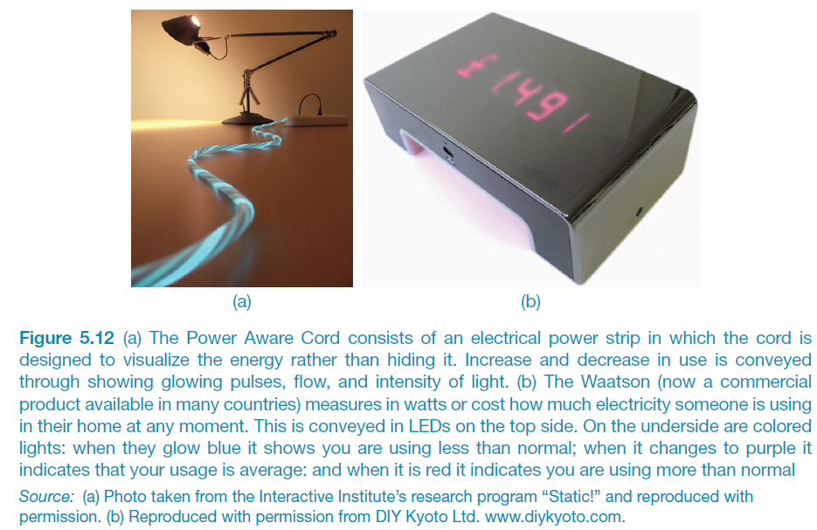
Energy Reduction

Slide 43
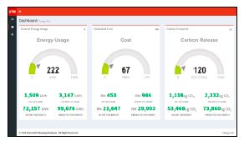
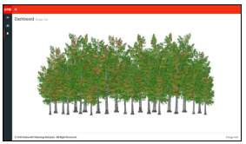
Energy Reduction via Peripheral Display

Slide 44
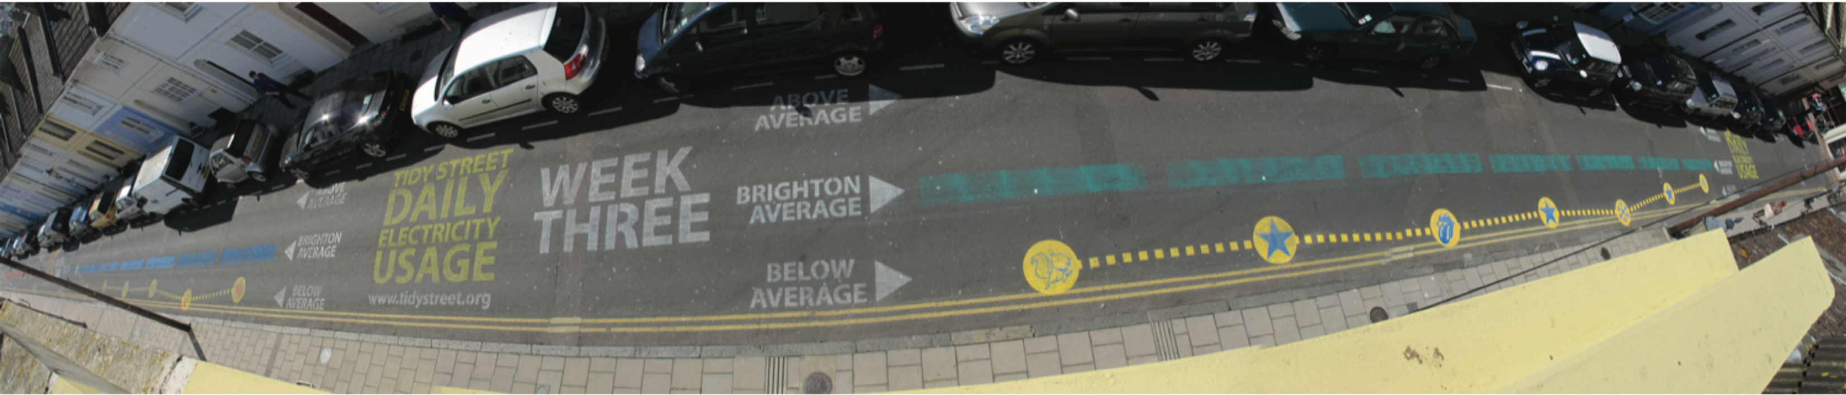
The Tidy Street Project
Large-scale visualization of the street’s electricity usage
Stenciled display on the road surface using chalk
Provided real-time feedback that all could see change each day
Reduced electricity consumption by 15 percent
(Bird and Rogers, 2010)

Slide 45
Phishing Scams
Web used to deceive people into parting with personal details
For example, PayPal, eBay, and “you won the lottery” emails
Allows Internet fraudsters to access their bank accounts and draw money from them
Many vulnerable people fall for it
The art of deception is centuries old but internet allows ever more ingenious ways to trick people

Slide 46
ANTHROPOMORPHISM

Slide 47
Anthropomorphism
Attributing human-like qualities to inanimate objects (for instance cars or computers)
Well known phenomenon in advertising
Dancing butter, drinks, and breakfast cereals
Much exploited in human-computer interaction
Make user experience enjoyable and motivating
Make people feel at ease by reducing anxiety
Furnishing technologies with personalities can make them enjoyable to interact with

Slide 48
Which message do you prefer?
As a welcome message:
“Hello Chris! Nice to see you again. Welcome back. Now what were we doing last time? Oh yes, Exercise 5. Let’s start again.”
“User 24, commence Exercise 5.”

Slide 49
Which do you prefer?
Feedback when user gets something wrong:
“Now Chris, that’s not right. You can do better than that. Try again.”
“Incorrect. Try again.”
Is there a difference as to what you prefer depending on type of message? Why?

Slide 50
Microsoft’s Clippy and IKEA’s Anna
Clippy was meant to be a helpful desktop agent
But was disliked by so many
annoying, distracting, patronizing
Anna appeared as a virtual agent
Blinked, moved her lips and head to suggest facial expressions

Slide 51
Error Messages
“The application Word Wonder has unexpectedly quit due to a type 2 error.”
Why not instead?
“The application has expectedly quit due to poor coding in the operating system”
Shneiderman’s classic guidelines for error messages include:
Avoid using terms like FATAL, INVALID, or BAD
Audio warnings
Avoid UPPERCASE and long code numbers
Messages should be precise rather than vague
Provide context-sensitive help

Slide 52
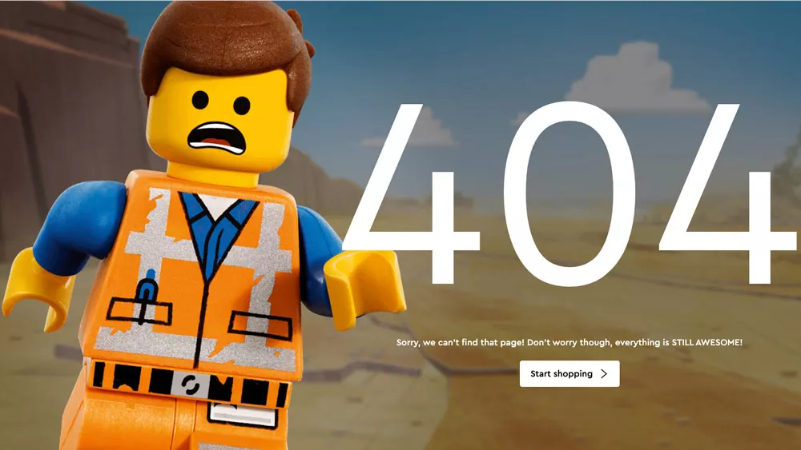
A funny image incorporated into a 404 error message

Slide 53
Evidence to Support Anthropomorphism
Reeves and Naas (1996) found that computers that flatter and praise users in educational software programs result in:
Positive impact on users
“Your question makes an important and useful distinction. Great job!”
Students were more willing to continue with exercises with this kind of feedback

Slide 54
Dilemma: Should computers say they’re sorry?
Reeves and Naas (1996) argue that computers should be made to apologize
Should emulate human etiquette
Would users be as forgiving of computers saying they’re sorry as people are of each other when saying they’re sorry?
How sincere would they think the computer was being? For example, after a system crash:
“I’m really sorry I crashed. I’ll try not to do it again”
How else should computers communicate with users?

Slide 55
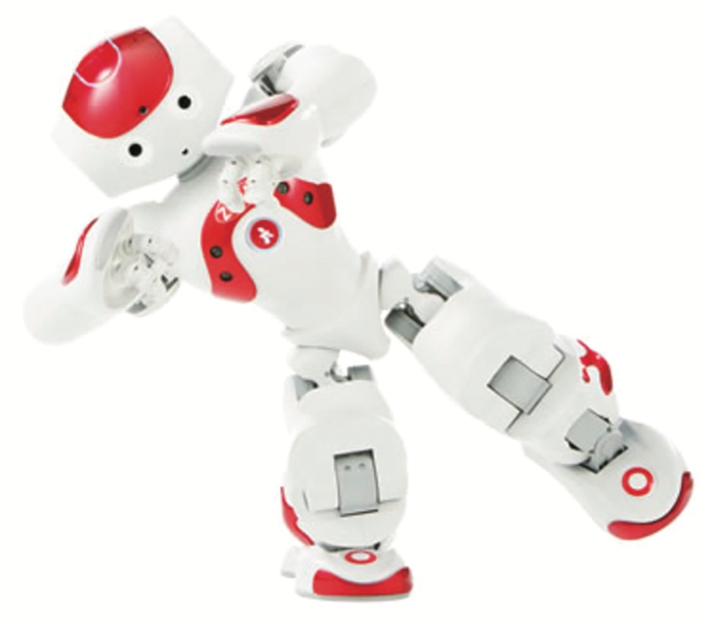
Should robots be plastic-pet like, cuddly-pet like or plastic-human like?
Aibo
The Haptic Creature
Zora

Slide 56
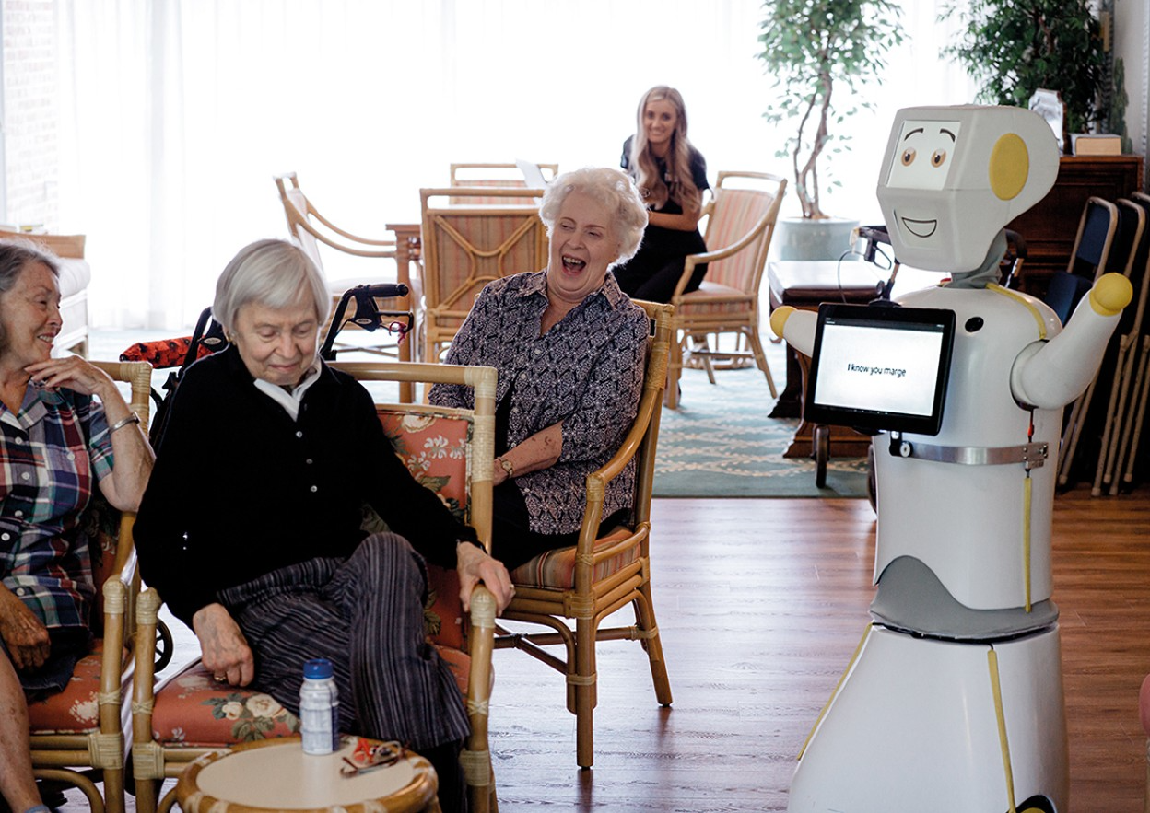
Stevie the robot entertaining residents while at retirement home

Slide 57
Is it OK for people to develop an emotional attachment with robots?
Commercial robots like Paro and Stevie are used in care homes to encourage social interactions with residents
play games, tell jokes, hold sing-alongs
some residents join in, others appear bemused while others find it a little demeaning
No harm in social robots playing an entertaining and motivating role alongside human caregivers
But they can never match the human touch and warmth that residents need

Slide 58
Summary
Emotional aspects of interaction design are concerned with how to facilitate certain states (for example, pleasure) or avoid reactions (for instance, frustration)
Well-designed interfaces can elicit good feelings in people
Aesthetically-pleasing interfaces can be a pleasure to use
Expressive interfaces can provide reassuring feedback to users
Badly designed interfaces make people frustrated, annoyed, or angry
Emotional AI and affective computing use AI and sensor technology for detecting people’s emotions by analyzing their facial expressions and conversations
Emotional technologies can be designed to persuade people to change their behaviors
Anthropomorphism is the attribution of human qualities to objects
Increasingly, robots are being used as companions in the home

